Slide 1
Adaptive RTL Control Unit for Power-Aware Control Unit
– Sayooj S
Rizwan

Slide 2
Problem Statement
Fixed RTL control units lack adaptability
Power and performance requirements vary at runtime
High-performance designs waste power
Power-optimized designs limit speed
Need for RTL-level adaptive control logic

Slide 3
Proposed Solution
We propose an adaptive control unit that switches between two RTL implementations:
Low-Power Mode: Uses sequential decoding to minimize switching activity
High-Performance Mode: Uses parallel decoding for faster execution
Both modes generate identical control signals, ensuring no functional difference while enabling runtime optimization.

Slide 4
Architecture Overview
The system takes opcode, mode, clock, and reset as inputs. It contains two internal control units and a multiplexer to select the output.
Low-Power block → sequential logic
High-Performance block → parallel logic
MUX selects output based on mode

Slide 5
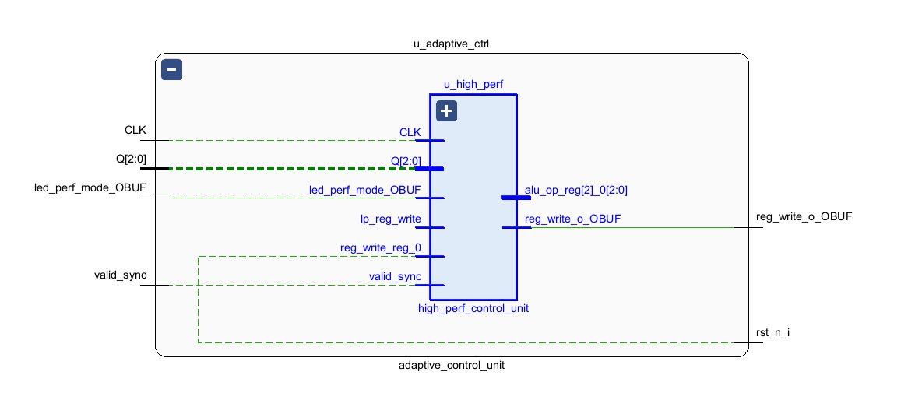
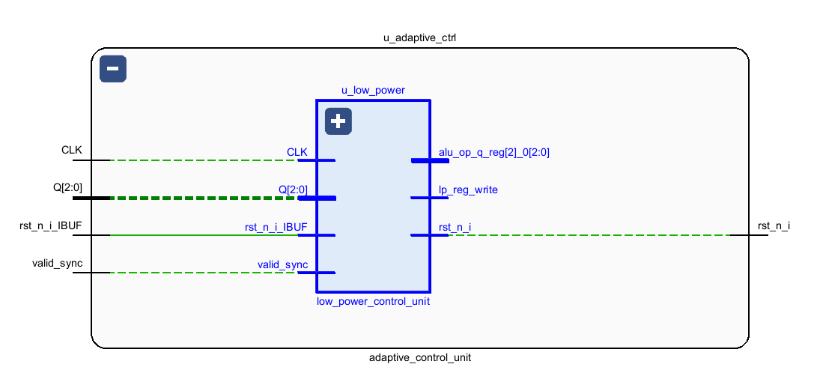
Performance and Power Results

Slide 6
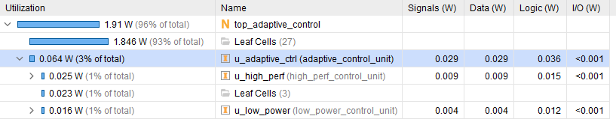
Power consumption

Slide 7
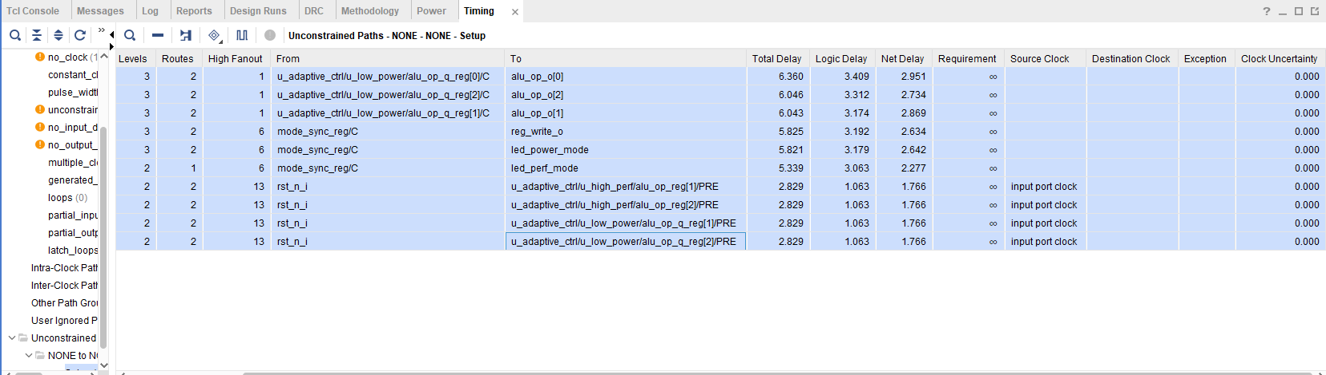
Timing analysis

Slide 8
CONCLUSION
RTL coding impacts power and timing
Adaptive control improves efficiency
Power-performance trade-off demonstrated
Achieved without datapath changes
Suitable for FPGA implementation

